Slide 1
WHAT IS JENKINS?
• Jenkins is an open-source continuous Integration server. • Jenkins supports the complete development life cycle of software. • Jenkins is a widely used application around the world that has growing day by day.

Slide 2
WHAT IS CONTINUOUS INTEGRATION?
• Continuous Integration is a process of integrating code changes from multiple developers in a single project many times. • Automate the build. • Continuous integration leads to continuous deployment allowing us to deliver software more rapidly.

Slide 3
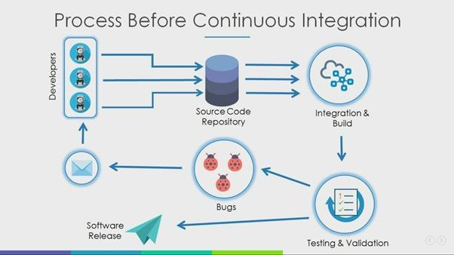
Why we need continuous Integration:
Problems faced before continuous Integration: 1. The developers need to wait for a long time to get build and test results. 2. Difficult to locate and fix the Bugs. 3. Software production process slow. 4. Continuous feedback is not present hence the development team is unaware of the software is working.

Slide 4
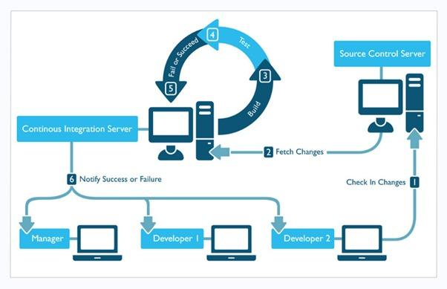
After Continuous Integration:
1. Developers are getting the Build and test results as soon as they change anything in the source code. 2. Locating and fixing of Bugs is easy using continuous integration. 3. Software development process is high. 4. Continuous feedback is present, hence the developer aware of the software working as soon as they commit any changes in source code.

Slide 5
Before Continuous integration | After Continuous Integration
The entire Source code was built and then tested. | Every commit made in the source code is built and tested.
Developers have to wait for test results | Developers know the test results of every commit made in the source code on the run.
No feedback | Feedback is present

Slide 6
The entire Source code was built and then tested. Every commit made in the source code is built and tested. Developers have to wait for test results Developers know the test results of every commit made in the source code on the run. No feedback feedback is present.
Tools: 1. Jenkins 2. TeamCity 3. Gitlab 4. Bamboo, etc.

Slide 7
Feature of Jenkins
Jenkins
Easy Installation
Easy Configuration
Plugins
Extensible
Distributed

Slide 8
Jenkins Pipeline
Code
Commit
Build
Test
Release
Deploy/
Deliver
Development
Production

Slide 9
Jenkins Architecture
Feedback
Developer 1
Jenkins CI server
Maven
Build server
Test Server
Source Code Repository
Developer 2
Production

Slide 10
Concepts involved in Jenkins's pipeline:
1. Pipeline - It is code executed for the build, test and deliver the applications and is a set of instructions in the form of code for continuous delivery
2. Node - It is a machine or system on which the Jenkins runs. A node block is pipeline syntax that is scripted.
3. Stage - It is used to visualize the process of Jenkins pipelines. It consists of a series of steps consisting of build, test, and deploy.
4. Step - It is a single step in the stage, for example, either build or test or deploy from a single step.

Slide 11
Jenkins Architecture
Jenkins follows Master-Slave architecture to manage distributed builds. In this architecture, slave and master communicate through TCP/IP protocol.
Jenkins architecture has two components:
Jenkins Master/Server
Jenkins Slave/Node/Build Server

Slide 12
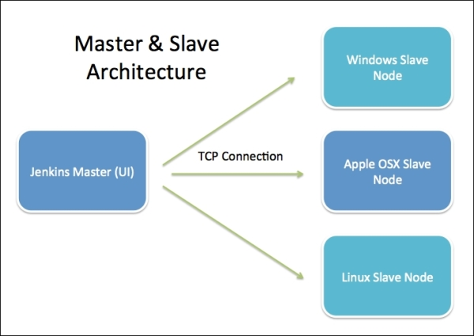

Slide 13
Jenkins Master
The main server of Jenkins is the Jenkins Master. It is a web dashboard which is nothing but powered from a war file. By default, it runs on 8080 port. With the help of Dashboard, we can configure the jobs/projects, but the build takes place in Nodes/Slave. By default, one node (slave) is configured and running in Jenkins's server. We can add more nodes using IP address, username and password using the ssh, jnlp or webstart methods.
The server's job or master's job is to handle:
Scheduling build jobs.
Dispatching builds to the nodes/slaves for the actual execution.
Monitor the nodes/slaves (possibly taking them online and offline as required).
Recording and presenting the build results.
A Master/Server instance of Jenkins can also execute build jobs directly.

Slide 14
Jenkins Slave
Jenkins slave is used to execute the build jobs dispatched by the master. We can configure a project to always run on a particular slave machine, or particular type of slave machine, or simple let the Jenkins to pick the next available slave/node.
As we know Jenkins is developed using Java is platform independent thus Jenkins Master/Servers and Slave/nodes can be configured in any servers including Linux, Windows, and Mac.

Slide 15
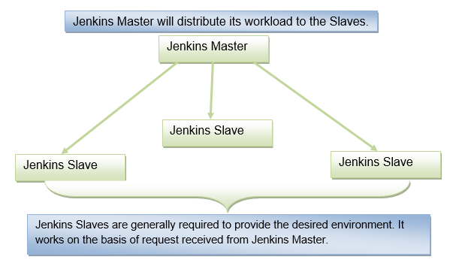
The above diagram is self-explanatory. It consists of a Jenkins Master which is managing three Jenkins Slaves.

Slide 16
Advantages of Jenkins
· It is an open-source tool.
· It is free of cost.
· It does not require additional installations or components. Means it is easy to install.
· Easily configurable.
· It supports 1000 or more plugins to ease your work. If a plugin does not exist, you can write the script for it and share with community.
· It is built in java and hence it is portable.
· It is platform independent. It is available for all platforms and different operating systems. Like OS X, Windows or Linux.
· Easy support, since its open source and widely used.
· Jenkins also supports cloud-based architecture so that we can deploy Jenkins in cloud-based platforms.

Slide 17
Disadvantages of Jenkins
The UX is messy compared to other solutions Jenkins doesn't have the best method of storing job configs in its related repo, unlike GitHub Actions or CircleCI You can't easily set an environment variable for the rest of your job from within a build step, if at all.
Can be difficult to configure Not the best error reporting.
It's not cloud-based.
It can be hard to figure out. High learning curve.
Have to maintain infrastructure yourself.

